Slide 1
Restaurants Dairy
By Dave DaCosta, Jake Adamson, Rob Cucchiara, Nate Ko

Slide 2
Overview
Save resturant that you have visited or want to visit
Allow user to make notes on their experience
Be able to search for new restaurant and restaurant they have been to to speed up the input of data

Slide 3
Video
https://drive.google.com/open?id=1F786J38BdChF-lpaFlR9ePmw2-QO4Wdy

Slide 4
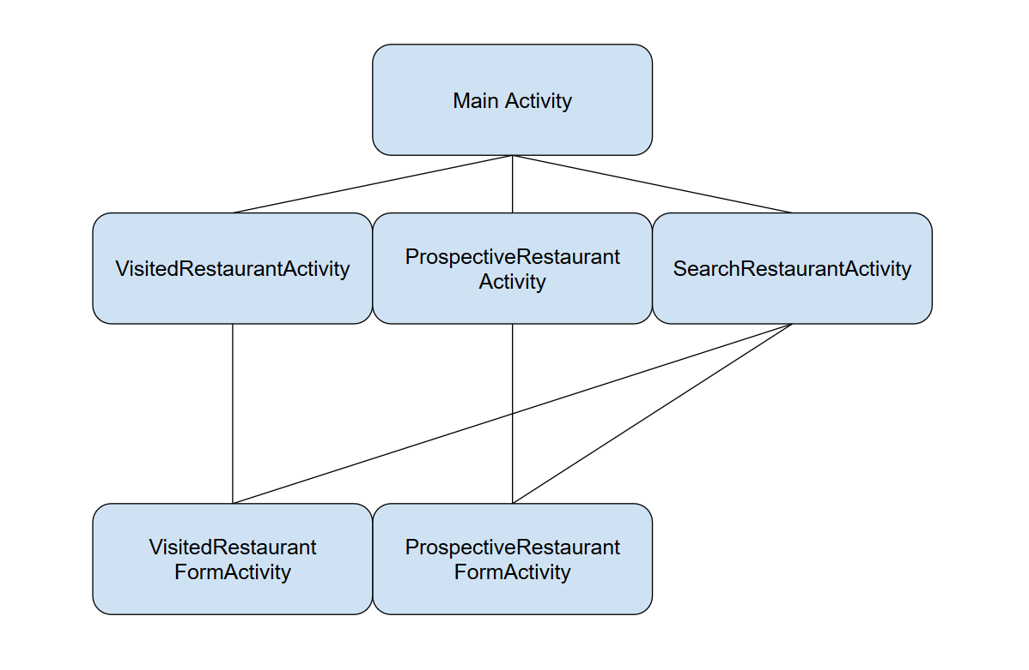
Architecture design
Activities
MainActivity, VisitedRestaurantActivity, ProspectiveRestaurantActivity, FormActivity, SearchRestaurantActivity
Databases
VISITED_RESTAURANTS
PROSPECTIVE_RESTAURANT
Apis
Yelp
Watson Ai
Notes:
ProspectiveRestaurantEntry._ID,
ProspectiveRestaurantEntry.COLUMN_RESTAURANT_NAME,
ProspectiveRestaurantEntry.COLUMN_RESTAURANT_ADDRESS,
ProspectiveRestaurantEntry.COLUMN_RESTAURANT_NOTE,
ProspectiveRestaurantEntry.COLUMN_RESTAURANT_PHONE,
ProspectiveRestaurantEntry.COLUMN_RESTAURANT_IMAGE

Slide 5
Implementation
Main Classes
AiSentimentCalculator, MainActivity, ProspectiveRestaurantActivity, ProspectiveRestaurantCursoryAdapter, ProspectiveRestaurantFormActivity, Restaurant, RestaurantAdapter, RestaurantLoader, SearchRestaurantActivity, VisitedRestaurantActivity, VisitedRestaurantCursoryAdapter, VisitedRestaurantFormActivity
Data Classes
RestaurantContract, RestaurantDbHelper, RestaurantProvider
Utility Classes
ImageUtils, QueryUtils

Slide 6
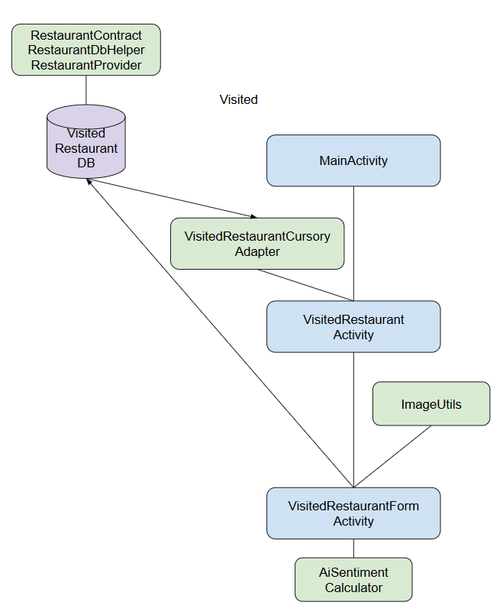
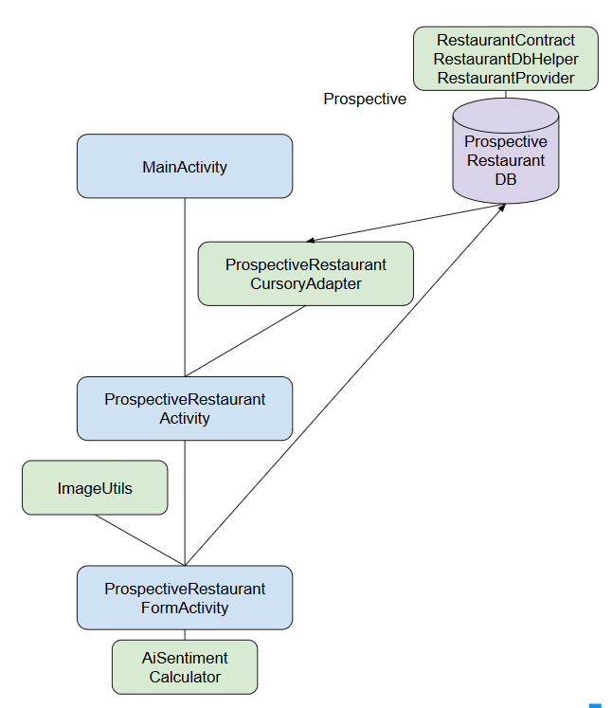
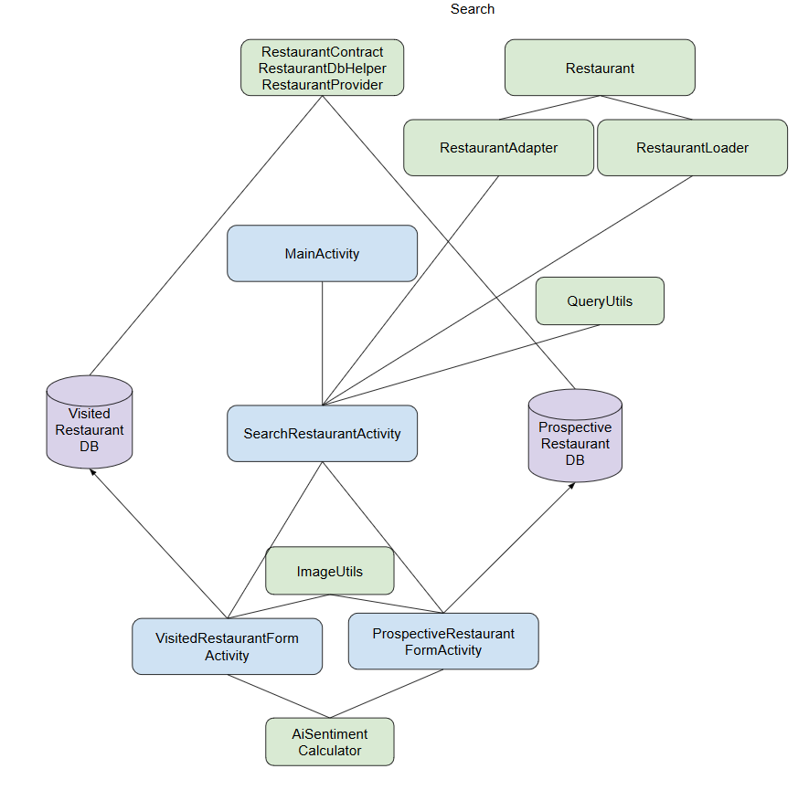
Implementation Flow

Slide 7
Extra Credit: AI/ML
IBM’s Watson Natural Language Understanding
Language
Sentiment
Emotion
What we did
Analyzed the users note and assigned a rating based on what Api returned

Slide 8
Individual Contributions
Dave: Worked on Service like integrating the Yelp Api, SearchActivity, and handing off search result to FormActivity for saving.
Jake: Worked on making all the activity display data from database, the logic of the activities, Ai implementation, helped people with Git, code reviews, and bug fixes.
Nathan: Implemented databases, inserting dummy data, helping others understand the database, code reviews, helped people with Git, and bug fixes.
Rob: Work on the GUI, formatting of displayed data, and stubs for any button or other GUI elements.

